Slide 1
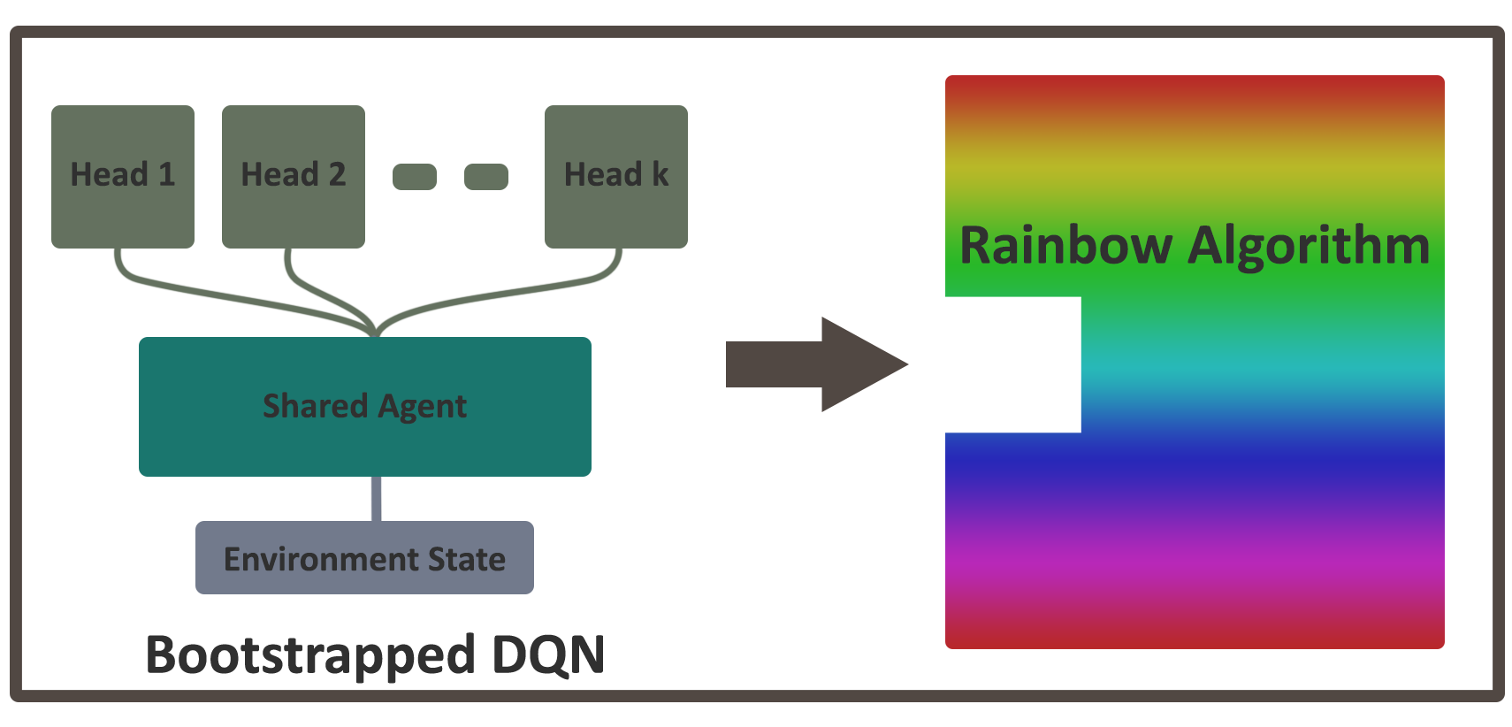
Rainbow Using Bootstrapped dqn
Presented by:
Shane Fearon
Notes:
NOTE:
To change the image on this slide, select the picture and delete it. Then click the Pictures icon in the placeholder to insert your own image.

Slide 2
Outline
Background and research domain
DQNs
Rainbow
Bootstrapped DQN
Experiments and results
Concluding remarks
Q&A

Slide 3
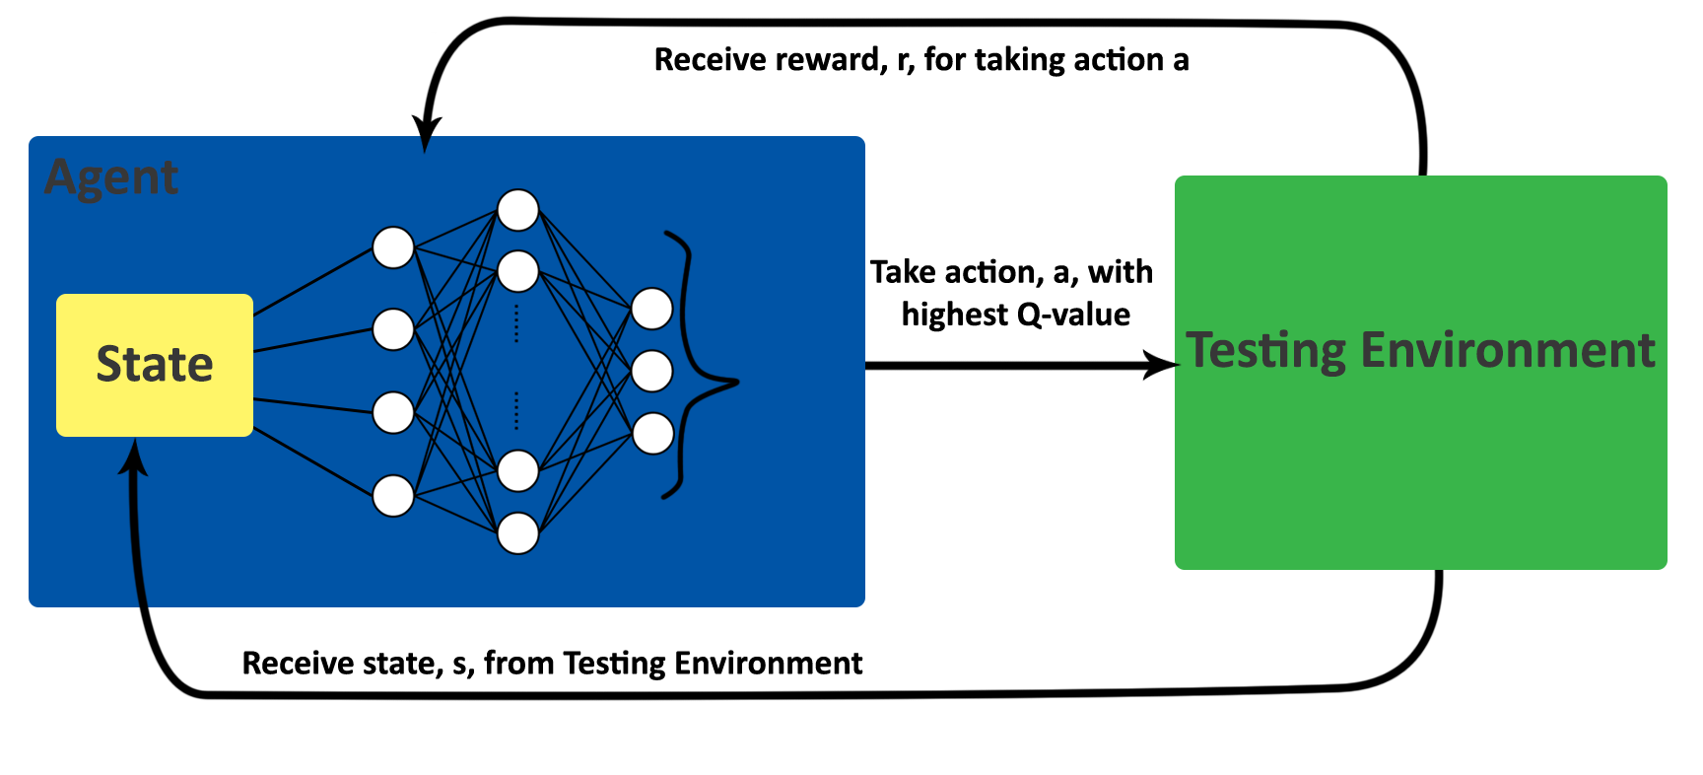
Background and research domain
Deep Q-Networks (DQNs)
DQNs combine Q-learning with Deep Learning through the use of Neural Networks to approximate the Q-values of actions based on a given state.
They consist of:
a Testing environment, which outputs a state and a reward, based on an input action, and;
an Agent, which decides what action, a, to take based on a state, s, given by the Testing Environment. It alters its action-selection policy by observing the reward, r, for taking an action.

Slide 4
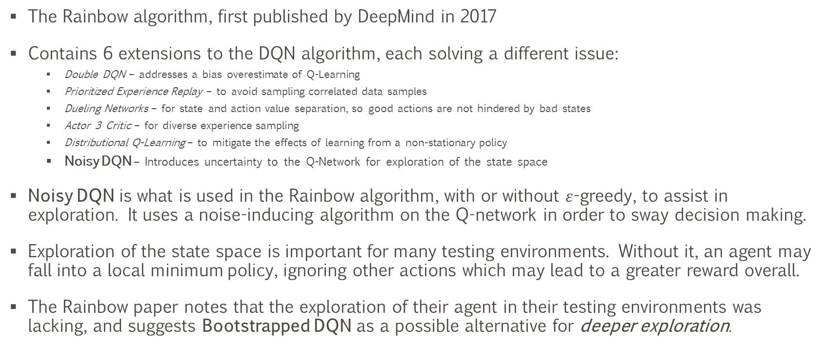
Background and research domain
Rainbow and Exploration
The Rainbow algorithm, first published by DeepMind in 2017
Contains 6 extensions to the DQN algorithm, each solving a different issue:
Double DQN – addresses a bias overestimate of Q-Learning
Prioritized Experience Replay – to avoid sampling correlated data samples
Dueling Networks – for state and action value separation, so good actions are not hindered by bad states
Actor 3 Critic – for diverse experience sampling
Distributional Q-Learning – to mitigate the effects of learning from a non-stationary policy
Noisy DQN – Introduces uncertainty to the Q-Network for exploration of the state space
Noisy DQN is what is used in the Rainbow algorithm, with or without $ε$-greedy, to assist in exploration. It uses a noise-inducing algorithm on the Q-network in order to sway decision making.
Exploration of the state space is important for many testing environments. Without it, an agent may fall into a local minimum policy, ignoring other actions which may lead to a greater reward overall.
The Rainbow paper notes that the exploration of their agent in their testing environments was lacking, and suggests Bootstrapped DQN as a possible alternative for deeper exploration.

Slide 5
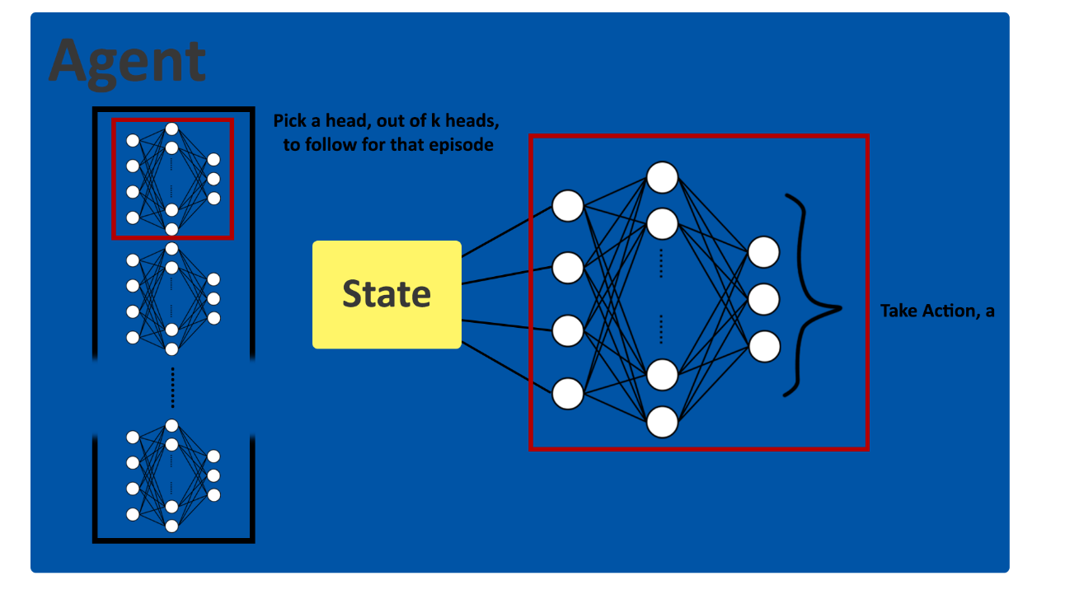
Bootstrapped DQN
Bootstrapped DQN for deeper exploration of the state space
Bootstrapped DQN works by using multiple “heads”, in our case, the heads are different Q-Networks, with randomized weights.
We select one of these heads to use for an entire episode of our testing environment, and follow the actions it decides on.
The states and rewards received for each action taken are used to train all of the heads, and each head has a separate “target network” which it is aiming for, which leads to a difference in decision making between heads.
When a head does find a better policy, some of the other heads will learn from this.
Eventually, the other heads will either find other good policies, or will learn the best policy found by the other heads.

Slide 6
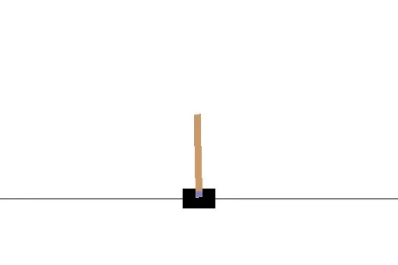
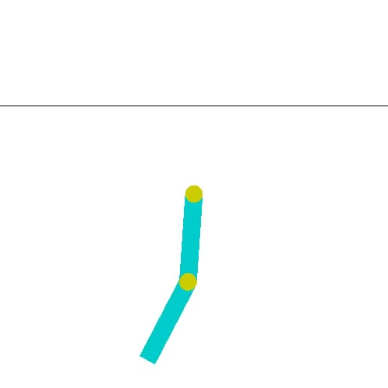
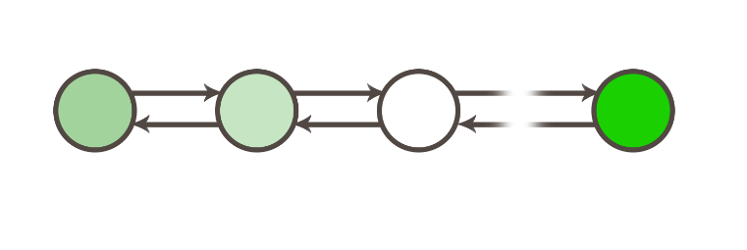
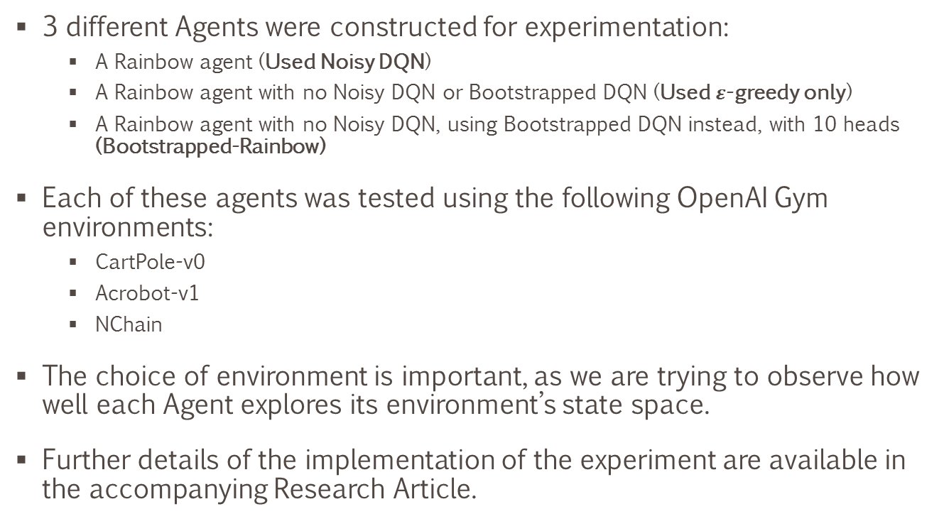
Experiments and results
Experiment outline
3 different Agents were constructed for experimentation:
A Rainbow agent (Used Noisy DQN)
A Rainbow agent with no Noisy DQN or Bootstrapped DQN (Used $ε$-greedy only)
A Rainbow agent with no Noisy DQN, using Bootstrapped DQN instead, with 10 heads (Bootstrapped-Rainbow)
Each of these agents was tested using the following OpenAI Gym environments:
CartPole-v0
Acrobot-v1
NChain
The choice of environment is important, as we are trying to observe how well each Agent explores its environment’s state space.
Further details of the implementation of the experiment are available in the accompanying Research Article.

Slide 7

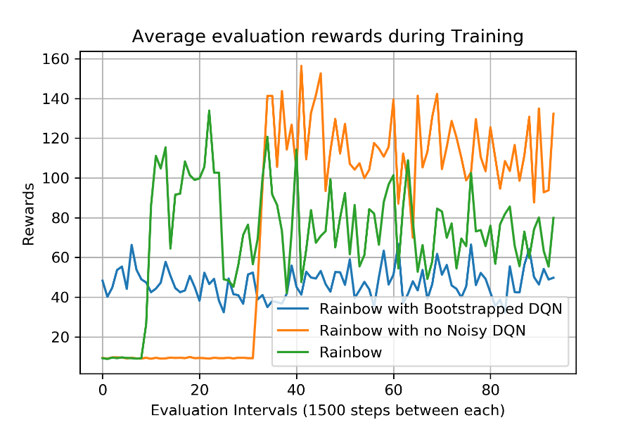
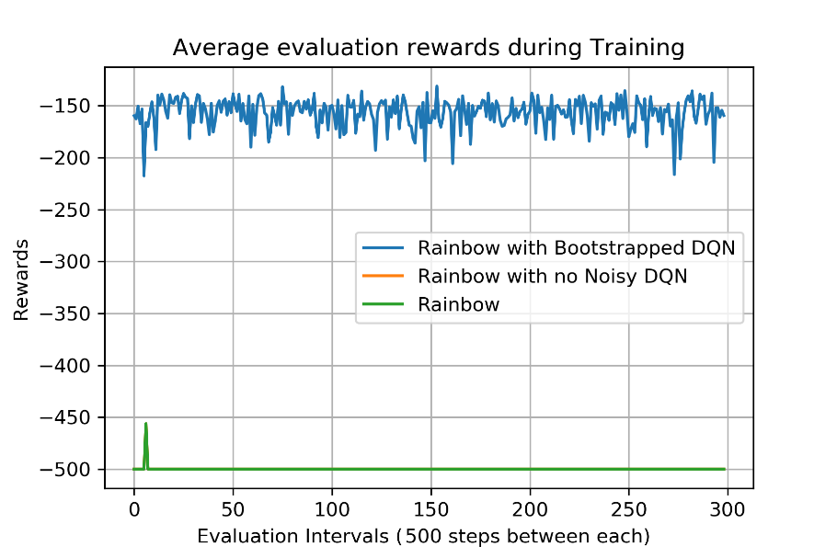
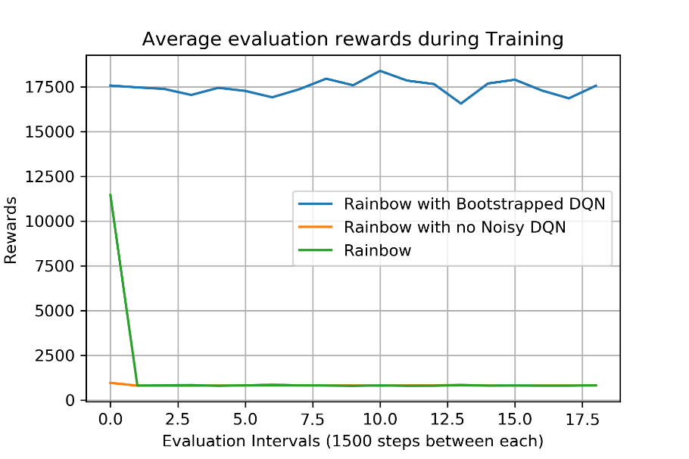
Experiments and results
Experiment Results
The results show the rewards for each agent using each environment, evaluated regularly throughout the training process. Bootstrapped-Rainbow’s rewards were taken from the best performing head.

Slide 8
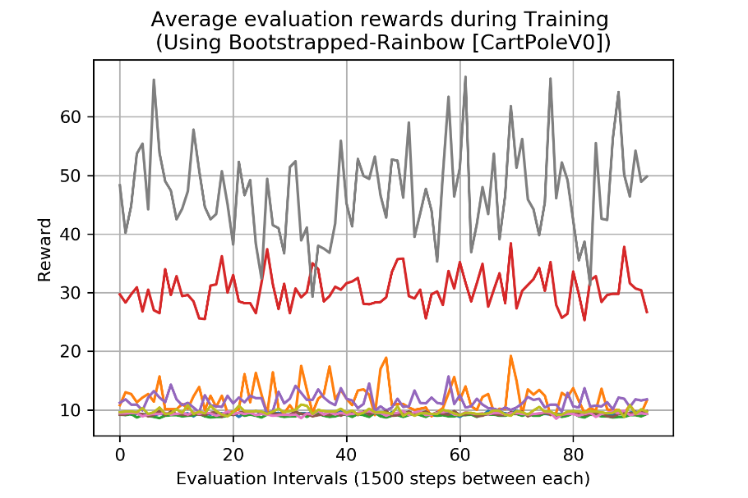
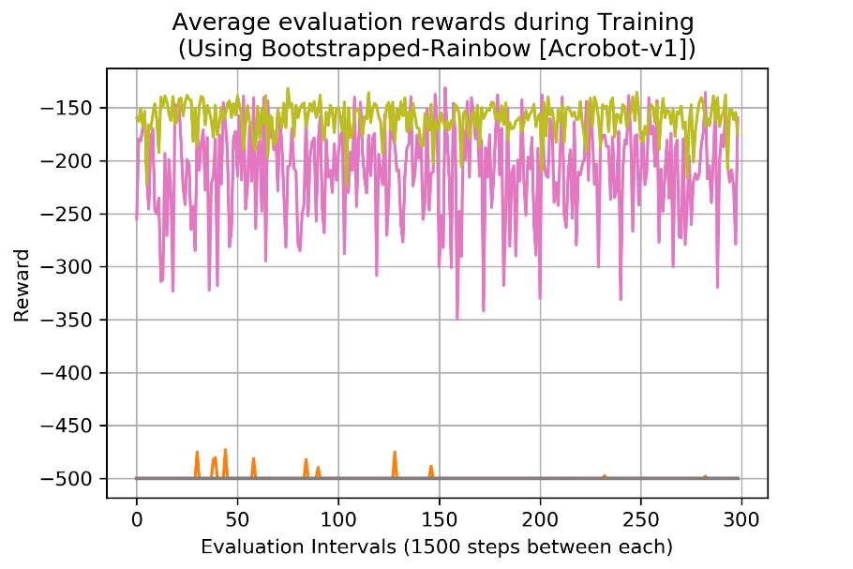
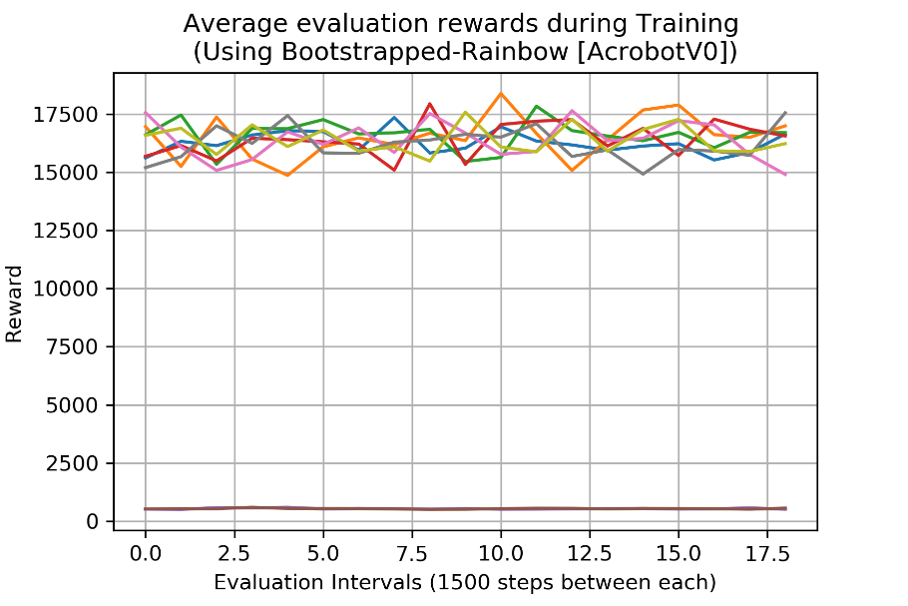
Experiments and results
Experiment Results – Bootstrapped-Rainbow’s heads’ rewards
The results here show the rewards achieved by each of Bootstrapped-Rainbow’s heads during the training period. Notice the large difference in reward between heads, which show the algorithm is exploring sub-optimal actions, which is what we set out to achieve.

Slide 9
Concluding remarks
Exploration vs Exploitation
The experiments show that using Bootstrapped-Rainbow in place of vanilla Rainbow can be very useful in certain environments where exploration is rewarded and encouraged, such as in Acrobot-v1 and NChain.
However, they also show the pitfalls of exploring too deeply, and of not exploiting the information that is available to the Agent to pursue a better policy, as in CartPole-v0.
Bootstrapped-Rainbow does not seem like a “one size fits all” exploration methodology for use in Rainbow, but it may be of use in those environments with sparse rewards, and with further tuning, could prove to be more useful in general testing environments.

Slide 10
Questioning period

